Slide 1
Classification

Slide 2
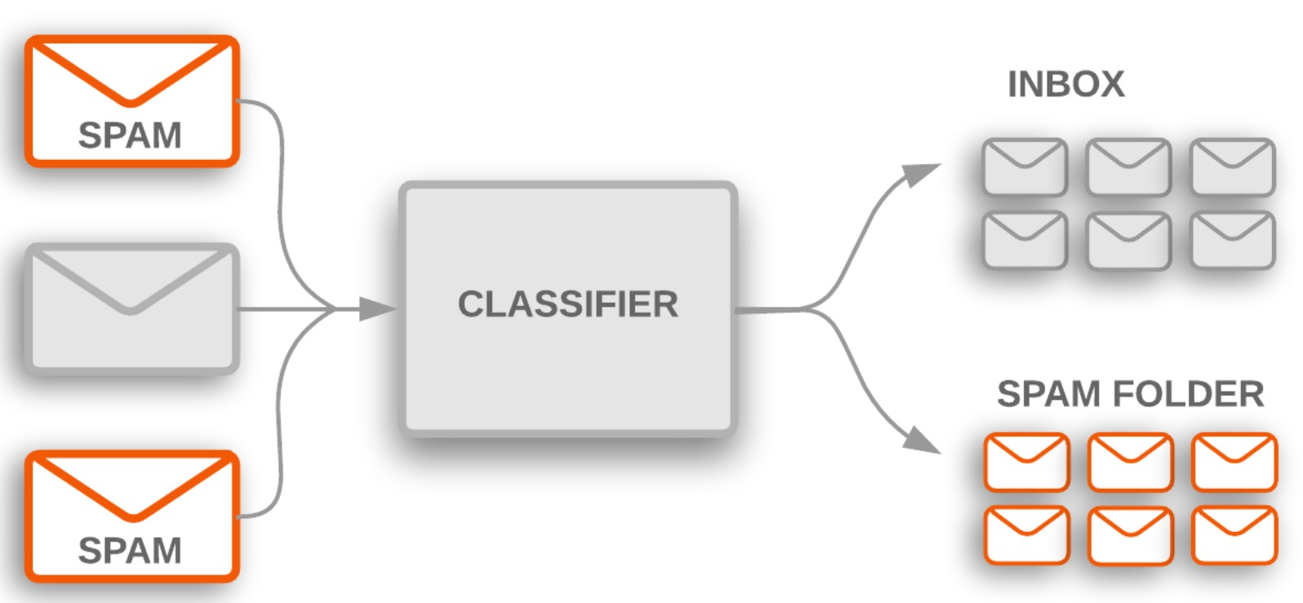
Classification:
Klassifikatsiya – tasniflash (sinflash)

Slide 3
Machine Learning Algoritmlar:
Support Vector Machine (SVM)
k-Nearest Neighbors
Decision Tree
Random Forest
Logistic Regression

Slide 4
Klassifikatsiya modellarini baholash uchun o’lchovlar:
Jaccard Index
Confusion Matrix
Accuracy
Recall
Precision
F1 score

Slide 5





Klassifikatsiya modellarini baholash uchun o’lchovlar:
Asl qiymatlar | 0 | 1 | 0 | 0 | 1 | 1 | 0 | 1 | 0
Bashoratlar | 0 | 1 | 0 | 1 | 1 | 0 | 1 | 1 | 1
Jaccard Index:
$$J=\frac{n(A∩B)}{n(A∪B)}= \frac{n(A ∩B)}{n\left(A\right)+n\left(B\right)−n(A∩B)}$$
$$= \frac{5}{9+9−5}= \frac{5}{13}=0.38$$
Eng yaxshi natija?
$$J=\frac{n(A∩B)}{n(A∪B)}$$
$$J=\frac{n(A∩B)}{n(A∪B)}= \frac{n(A)}{n\left(A\right)+n\left(A\right)−n\left(A\right) }= \frac{n(A)}{n\left(A\right)}=1$$
$$n\left(A\right)=n(B)$$
$$n\left(A∩B\right)=n\left(A\right)=n(B)$$

Slide 6
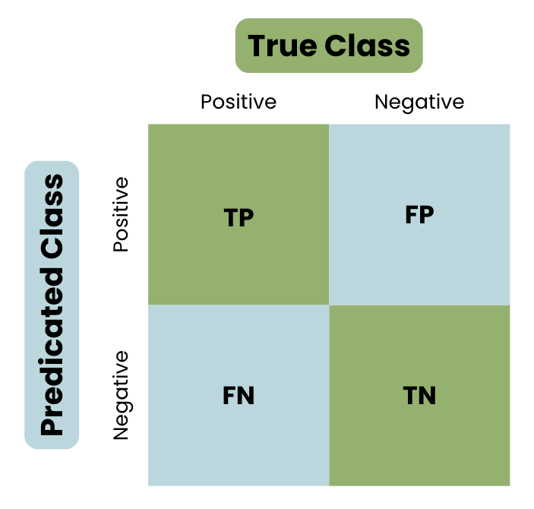






Klassifikatsiya modellarini baholash uchun o’lchovlar:
Asl qiymatlar | 0 | 1 | 0 | 0 | 1 | 1 | 0 | 1 | 0
Bashoratlar | 0 | 1 | 0 | 1 | 1 | 0 | 1 | 1 | 1
Confusion Matrix:
Matrix:
Eng yaxshi holat:
$$TP=3$$
$$FP=1$$
$$\left[ \begin{matrix}3 & 1 \\ 3 & 2\end{matrix} \right]$$
$$\left[ \begin{matrix}4 & 0 \\ 0 & 5\end{matrix} \right]$$
$$FN=3$$
$$TN=2$$

Slide 7
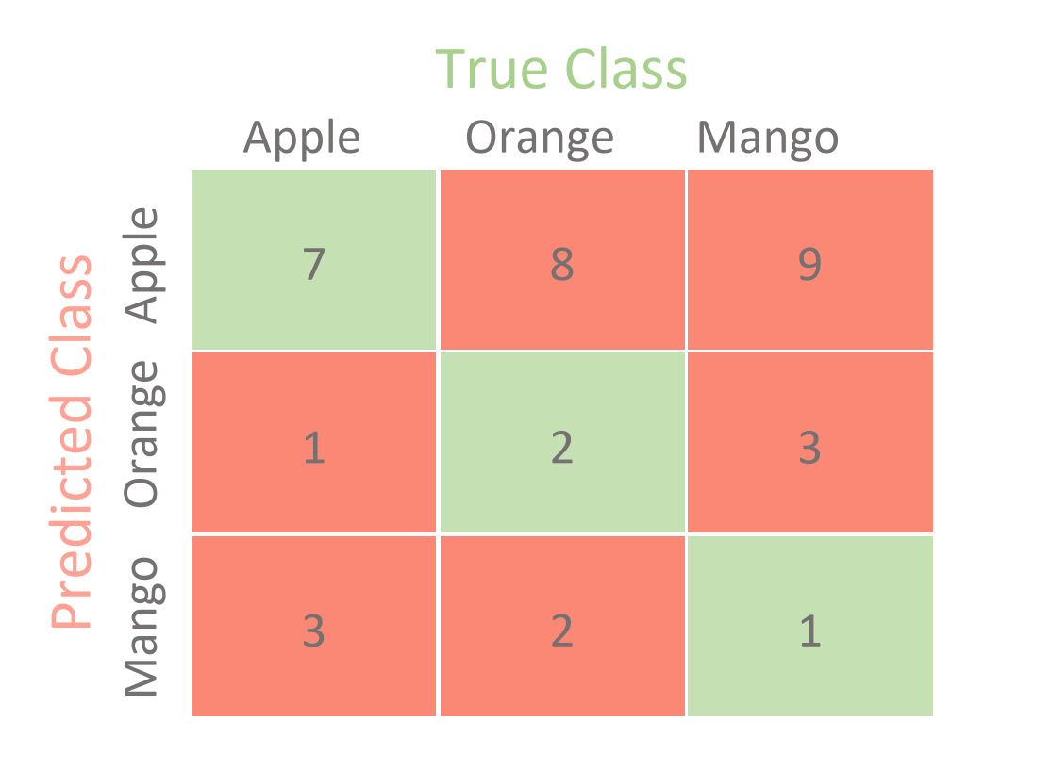






Ikkitadan ortiq sinflar uchun Confusion Matrix:
Matrix:
Eng yaxshi holat:
$$\left[ \begin{matrix}3 & 1 \\ 3 & 2\end{matrix} \right]$$
$$\left[ \begin{matrix}4 & 0 \\ 0 & 5\end{matrix} \right]$$
$$TP=3$$
$$FP=1$$
$$FN=3$$
$$TN=2$$

